Slide 1
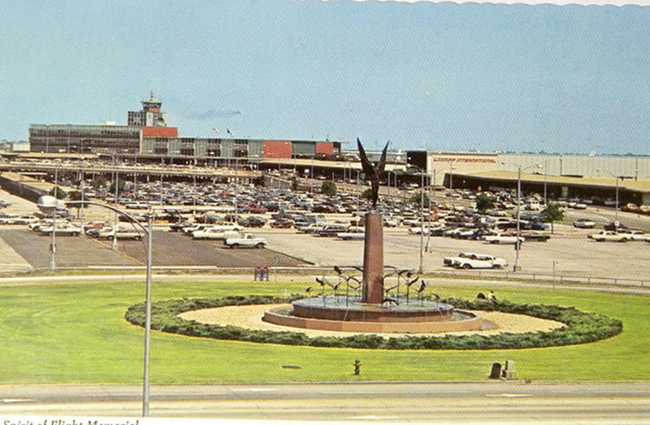
Love Field
Environmental
Advisory Committee
Meeting
January 13th, 2022
Dallas Love Field
7555 Lemmon Ave

Slide 2
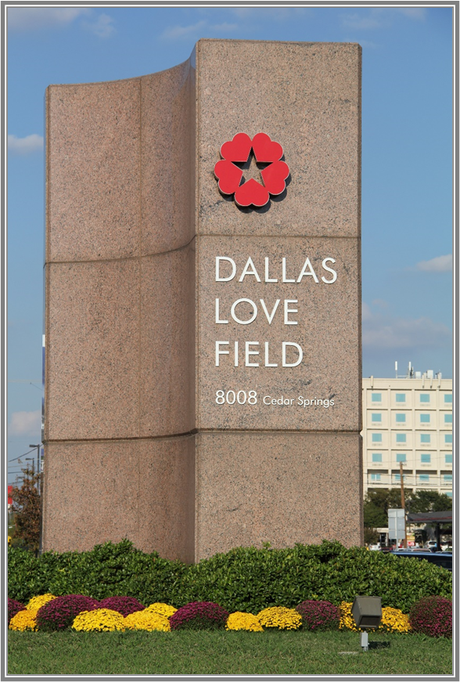
Agenda
Introductions
Runway 13R/31L Reconstruction
Voluntary Noise Program
  Noise Reports
Public Comment Period
Adjourn

Slide 3
Runway 13R/31L Taxiway C Phase 1
Reconstruction

Slide 4
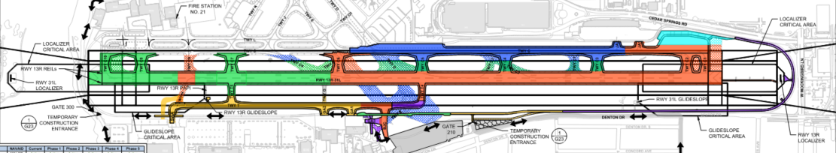
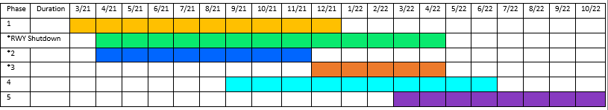
Overall Project 46%
Phase-1 is at 99%
Phase-2 & 3 is at 60%
Phase -4 is at 15%

Slide 5
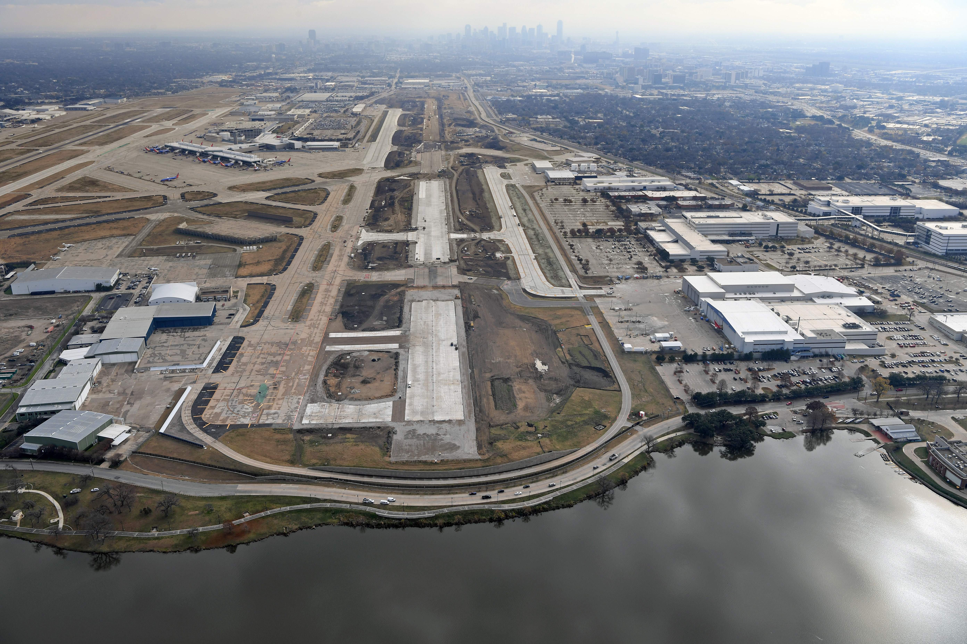
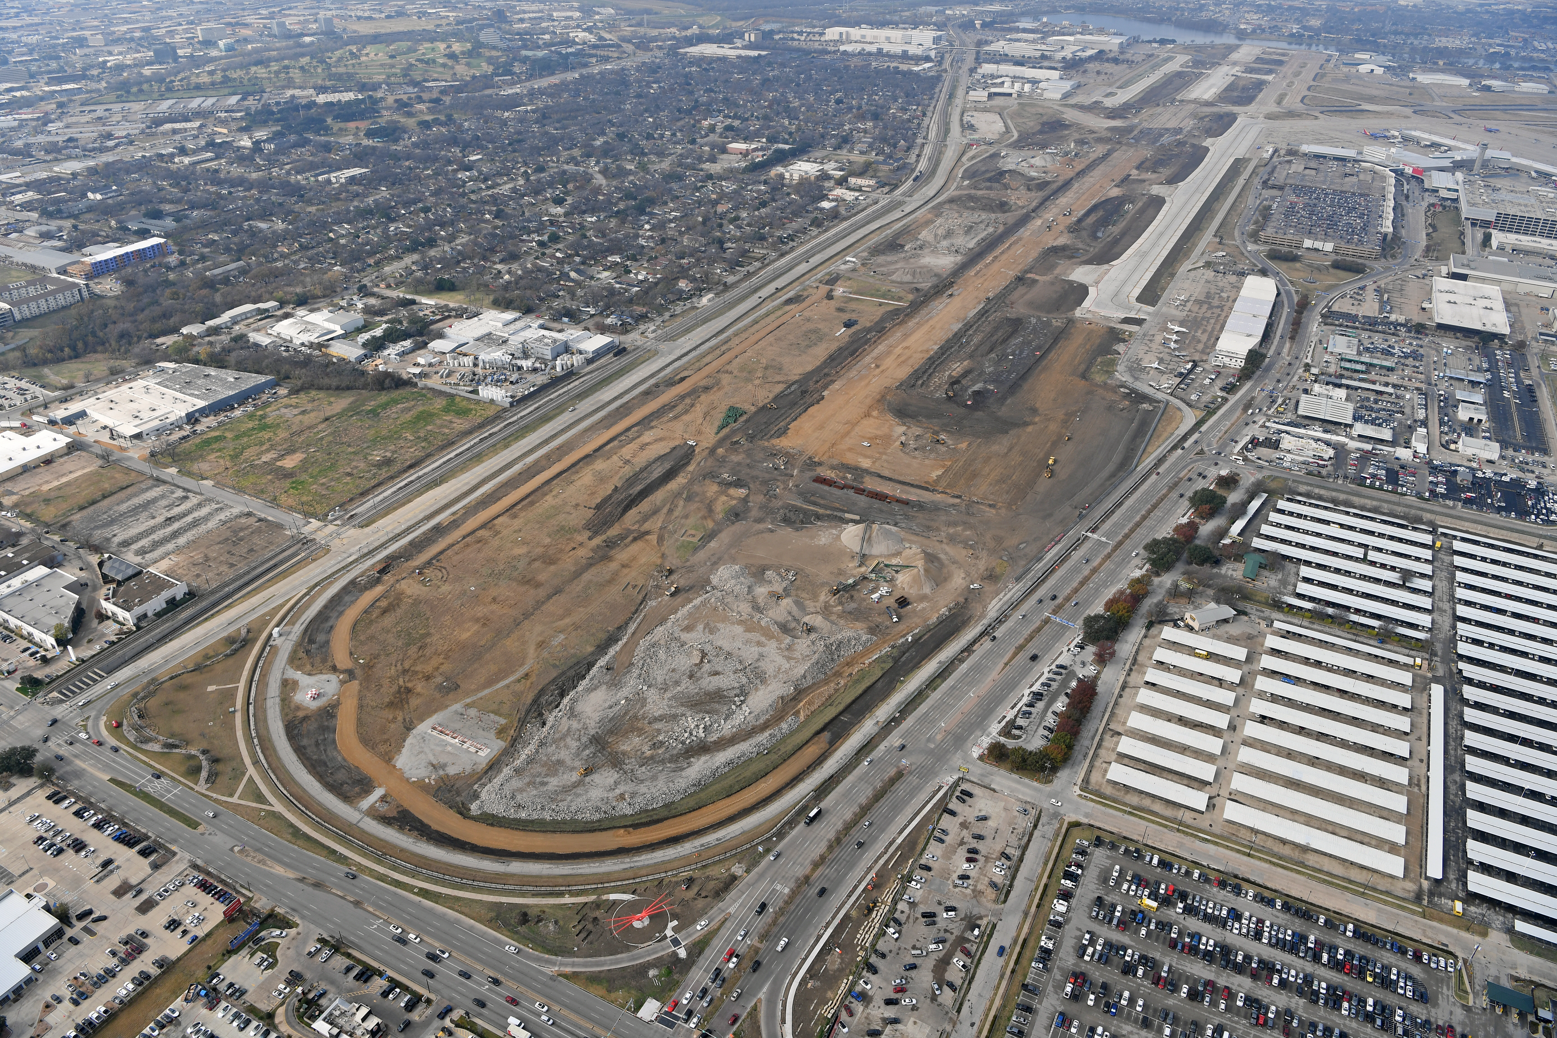
Runway 13R-31L Reconstruction
Figure 1 - RWY 13R looking SE
Figure 2 - RWY 13R/31L and TWY C under construction
Notes:
Some photos from the air of the construction

Slide 6
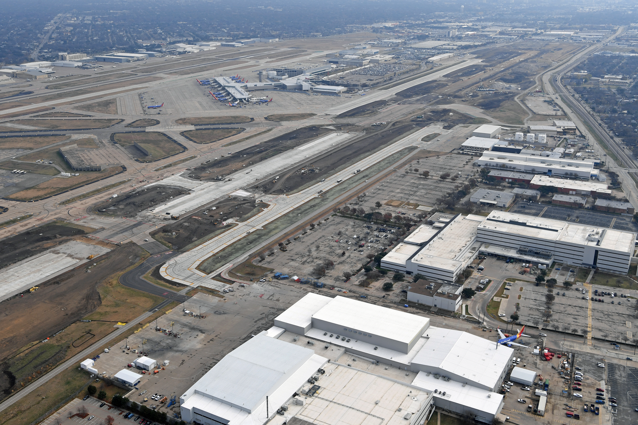
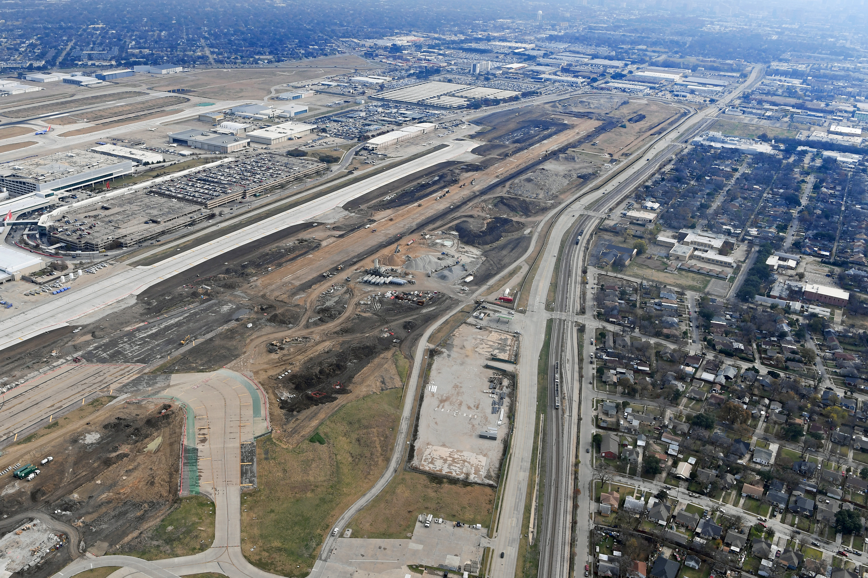
Runway 13R-31L Reconstruction
Figure 3 - New TWY T under construction (Phase 1) and north half of RWY 13R/31L under construction (Phase 2)
Figure 4 - TWY C under operation

Slide 7
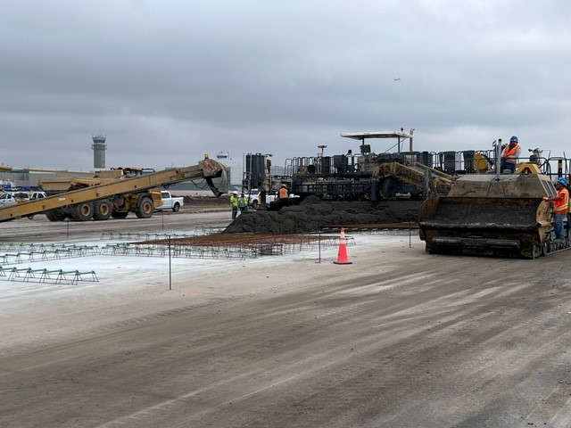
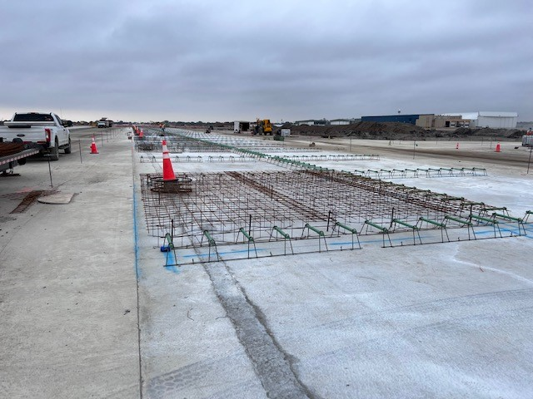
Runway 13R-31L Reconstruction
Figure 5 – RWY 13R/31L with reinforcements and placing final concrete pavement layer
Figure 6 – RWY 13R/31L, final pavement layer preparation

Slide 8
Voluntary Noise
Program

Slide 9
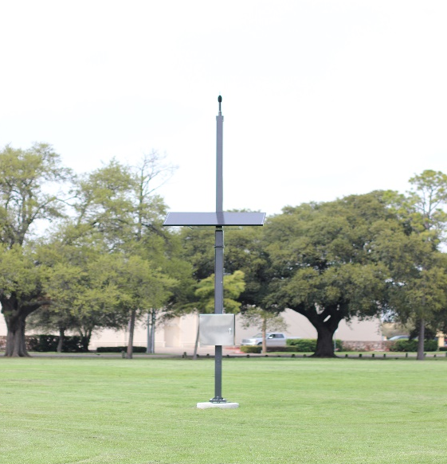
Dallas Love Field’s Voluntary Noise Program
To better respond to the concern of our neighbors, the City of Dallas’ Department of Aviation has developed a Voluntary Noise Control Program for the Airport.
DOA serves as a liaison between the community and FAA while also disseminating noise information to stakeholders through outreach.
The Federal Aviation Administration controls the National Airspace System in the United States.
FAA’s Air Traffic Control directs commercial air traffic to and from DAL Airport.
DAL’s Noise and Operations Monitoring System (NOMS) utilizes Casper Airport Solutions as its advanced system that enables the City of Dallas to monitor and better understand aircraft noise in the vicinity of the Airport. The system is comprised of 4 fixed noise monitors in the community.

Slide 10
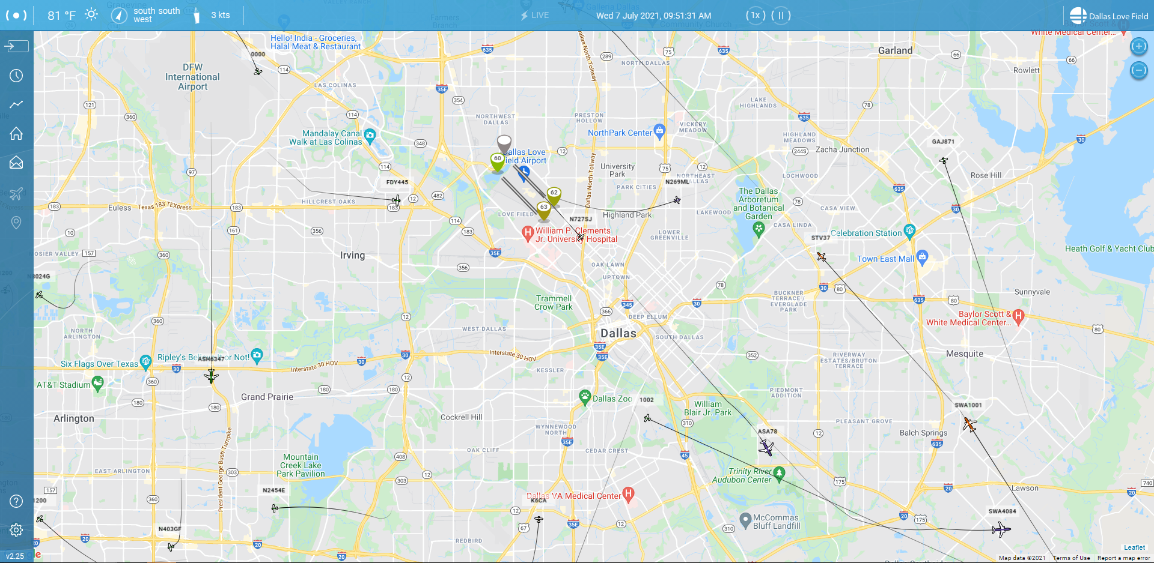
Flight Tracker
As part of the Voluntary Noise Program, Dallas Love Field Airport invested in an online tracking system for the movement of flights and air traffic patterns within the DFW Metroplex. Flight Tracker along with Casper NoiseLab allows concerned individuals to research data about flights to and from Dallas Love Field Airport or Dallas Executive Airport as well as any transitional air traffic through the region. The system also simplifies the process of filing a noise complaint by offering an easy, online option for residents to register noise concerns.
https://flighttracker.casper.aero/dal/

Slide 11
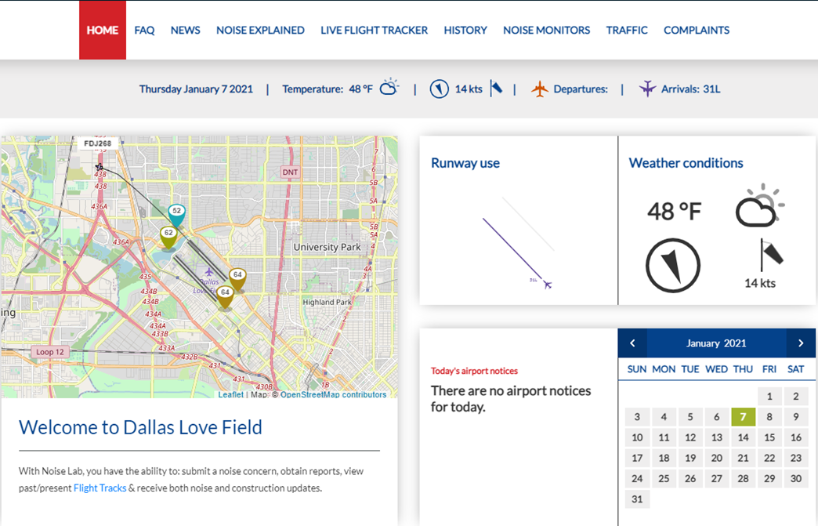
NoiseLab
Https://dal.noiselab.casper.aero/

Slide 12
Operation Statistics (Oct – Dec 2021)
Definitions
Air Carrier – A commercial carrier utilizing aircraft as its means of transport; an airline, as for passengers or freight.
General Aviation – All civil aviation operations other than scheduled air services and non‐scheduled air transport operations
for compensation or hire.
Other – Medical and Military flights
Source: Casper Airport Solutions Inc.

Slide 13
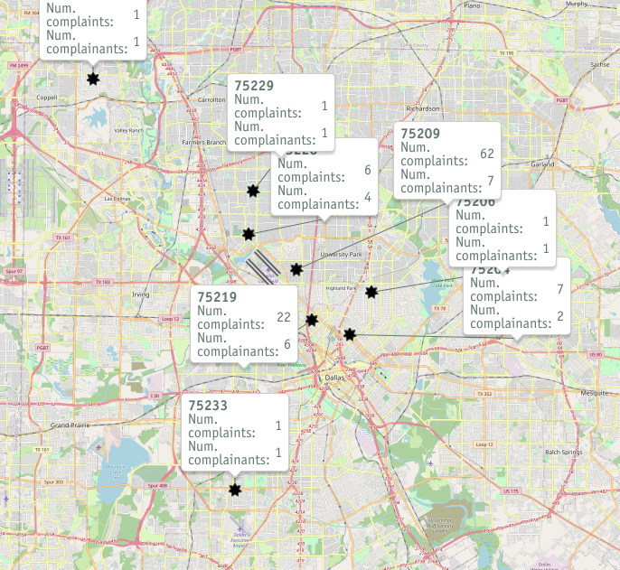
Noise Complaints
Oct – Dec 2021
*Disclaimer: The map only displays zip codes
in the immediate Dallas Love Field area
Source: Casper Airport Solutions Inc.

Slide 14
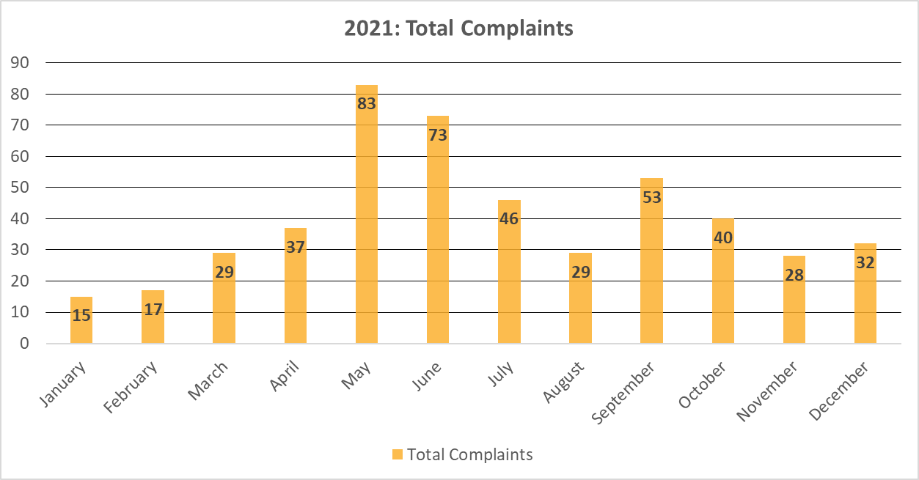
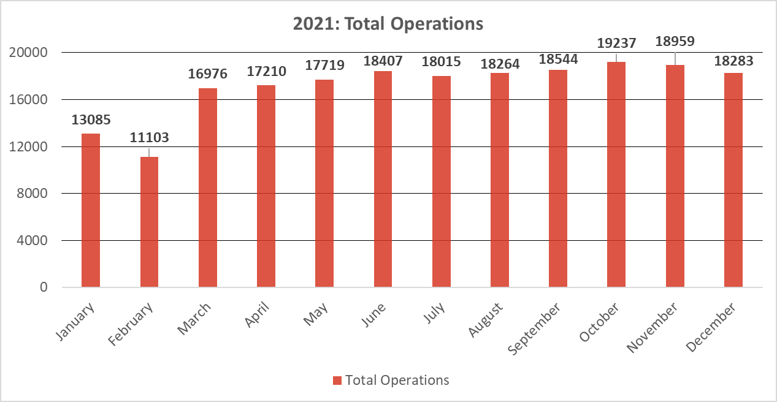
CY 2021 Total Operations & Complaints
Source: Casper Airport Solutions Inc.

Slide 15
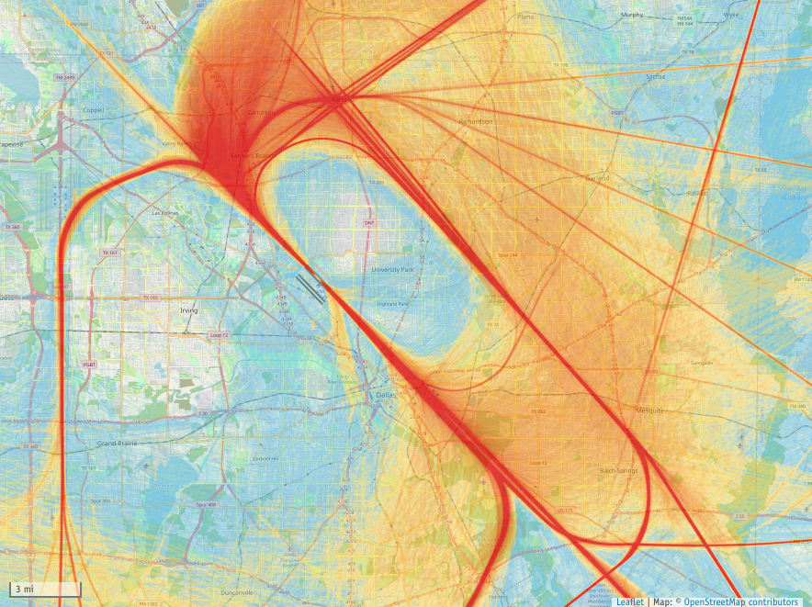
Radar Track
Density Map
Source: Casper Airport Solutions Inc.
(Oct – Dec 2021)
The following map takes all the flight track data for the given time period and creates a line density plot. Dark red in the middle of the picture shows the highest density of flight tracks over the runways. The colors gradually move out to blue as the least dense.

Slide 16
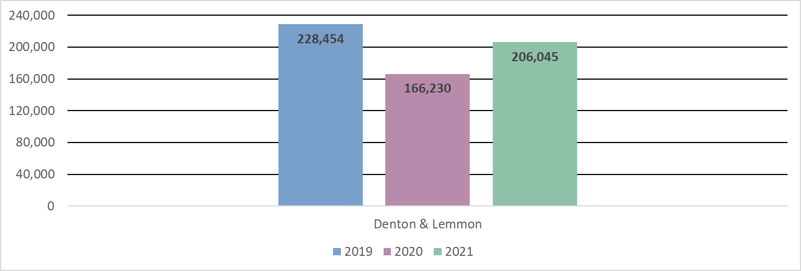
Covid Impacts on Operations: CY 2019 & 2020 vs 2021
Source: Casper Airport Solutions Inc.

Slide 17
Open Discussion and Questions

Slide 18
Adjourn
Next LFEAC Meeting
on
April 14, 2022, at 6 p.m.
For noise concerns visit
https://dal.noiselab.casper.aero/
For noise inquires email
AVINoise@dallascityhall.com

